Slide 1
Testing with SonarQube
Hadi Nazemi

Slide 2
Introduction
Unit Testing
Integration Testing
Test organization
Jacoco
Sonar and its elements
Quality gates
Integration with CI

Slide 3
Introduction
Why we write tests?
Making the process Agile
  no need to wait for testers, not now->when test coverage is enough
Quality of Code
  how quickly developers can add business value to software system
Reduce costs
  Find software bugs faster (developer write them)
Code coverage (how many lines are covered by test)
  Functionality coverage (how much of functionality is covered)
Debug process is easy
  Without running application server(like Weblogic, etc)

Slide 4
Unit Tests
test each unit (an individual component) of the software application.
A unit is a single testable part of a software system.()
Purpose: test the correctness of isolated code.
Ex: validate amount of money, validate Shaba number(format, size,…)
Public methods in service modules

Slide 5
Advantage of UT
Reduces Defects in the New features that developed
or reduces bugs when changing the existing functionality.
Reduces Cost of Testing (because It’s in very early phase).
Improves design and allows better refactoring of code.
show the quality of the build, when integrated with build .(surefire plugin)

Slide 6
Integration Tests
units or individual components of the software are tested in a group.
Ex: transfer money from user P to Q
Purpose: expose defects at the time of interaction between integrated components or units.
In memory DB (h2-database , ..)
(methods in façade classes) /fəˈsäd/
FailSafe plugin-> generate reports for Its
Scenarios in test:
  Public void SUT(system under Test)_condition_result(){assert_sth();}
  We have a class for sut so remove that from first of testMethods

Slide 7
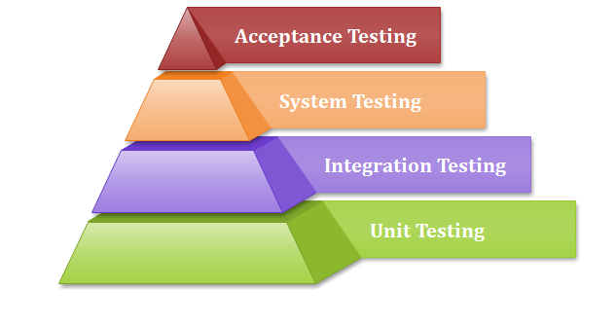

Slide 8
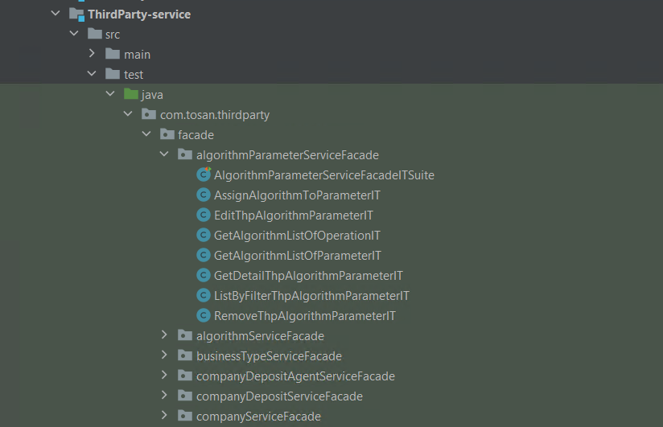
How to find test class in services?( UT, IT, ITSuite, UTSuite)

Slide 9
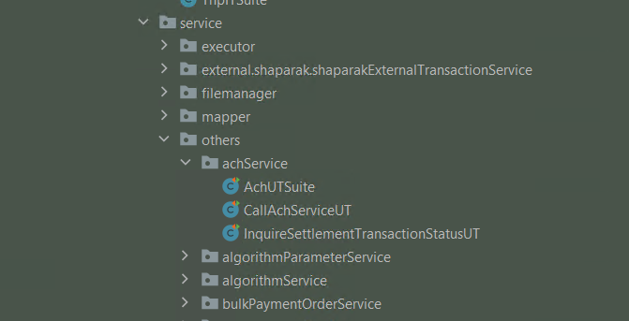

Slide 10
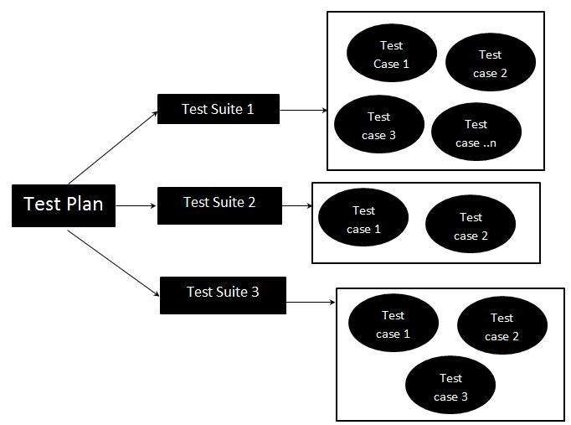
Test organization
Using suite classes
Collect some tests and run them
  ex blocker bugs of 4012 basket
  Ex : ThpITSuite, ThpUTSuite

Slide 11
Jacoco
Code coverage: how many lines of our code are executed during automated tests.
Add maven plugin used in https://www.baeldung.com/jacoco
When running Tests, It creates a coverage report in binary format in the target directory, target/jacoco.exec.(and also other formats like HTML) in target/site/jacoco/index.html
    Sonar Qube. Can read this file and show that in web UI.
With failSafe & sureFire ->you can seprate IT and UT classes and generate seperate reports(with jacoco).

Slide 12
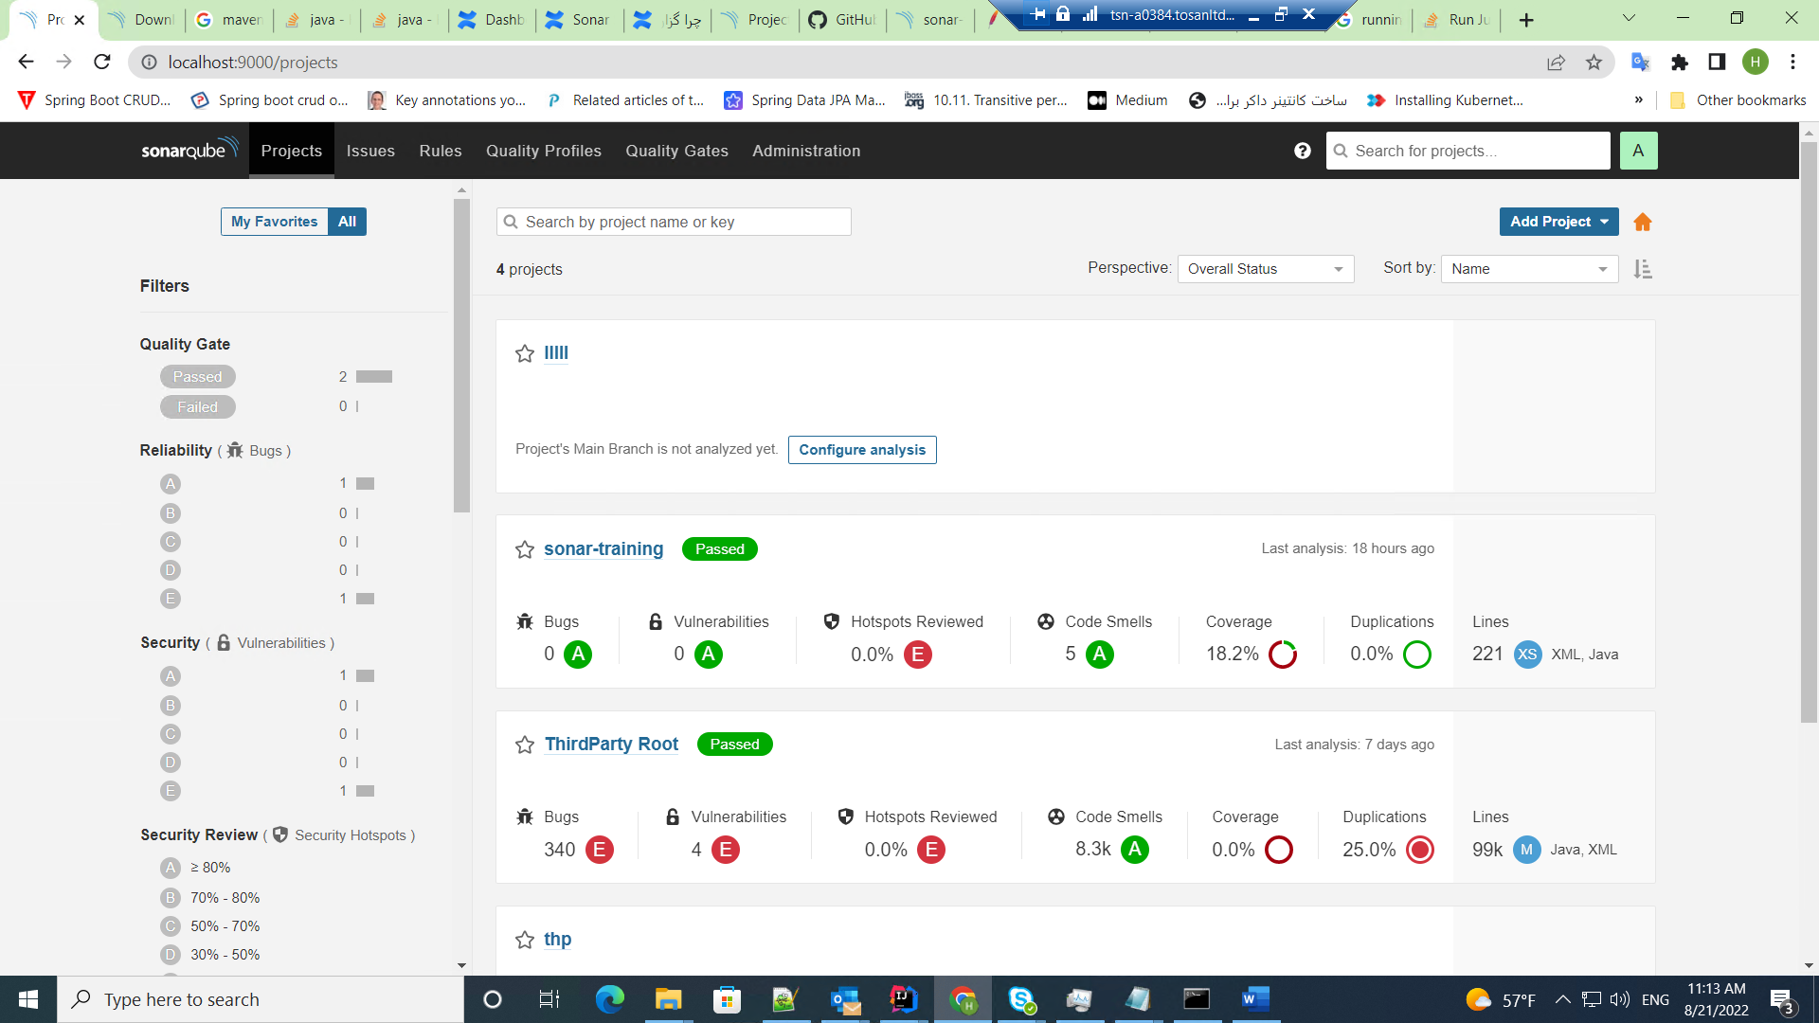
How to see code coverage???
1) See coverage with sonar

Slide 13
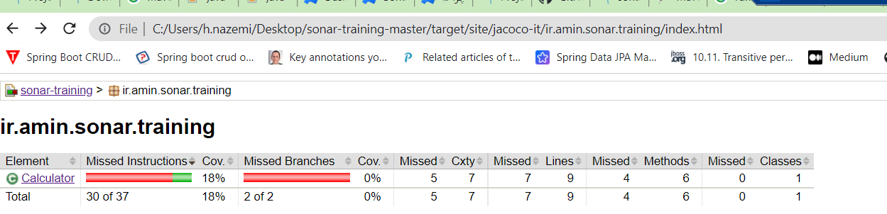
2)See coverage in project’s modules
Go to target/site/jacoco/index.html
Click on element name and see the coverage on lines of code

Slide 14
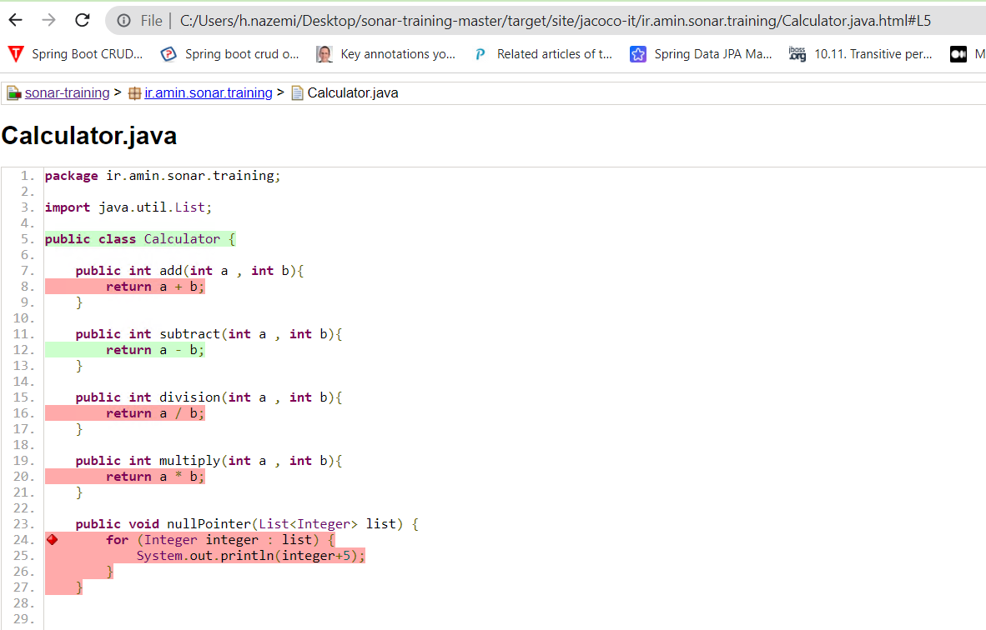

Slide 15
Build project :
Build and run only unitTests:
in general : mvn clean install –DskipITs
or :mvn integration-test verify -Dskip.unit.tests=true
(skip.unit.tests is a property in pom.xml)
Build and run only Integration Tests:
in general : mvn clean install –DskipUTs
or :mvn clean test verify -Dskip.integration.tests=true
Buid and run suiteTest:
mvn -Dtest=CalculatorITSuite test

Slide 16
What is SonarQube?
Is an open-source software quality platform
  saves the calculated measures in a database
  show them in a web-based dashboard
Offers reports on duplicated code(copy/paste), coding standards, unit tests, code coverage, code complexity, potential bugs, comments, design, and architecture.
Provides fully automated analyses: integrates with Maven, Ant, Gradle, and
continuous integration tools (Atlassian Bamboo, Jenkins, Hudson, etc.).
Integrates with external tools: JIRA, Mantis, LDAP, Fortify, etc.

Slide 17
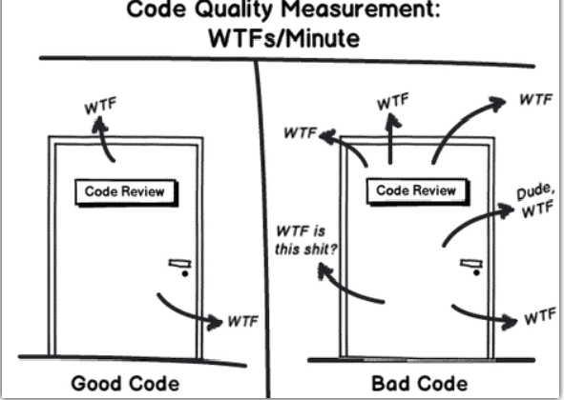
Purpose of Sonarqube?
Is Code quality, reliability, maintainability over the life-span of the project.
a poorly written codebase is always more expensive to maintain.

Slide 18
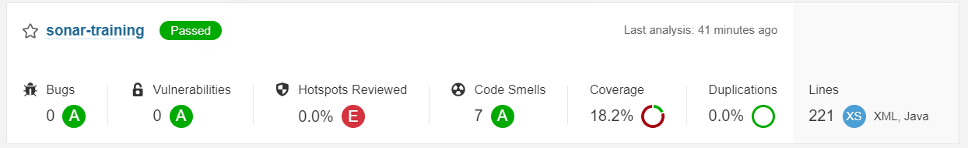
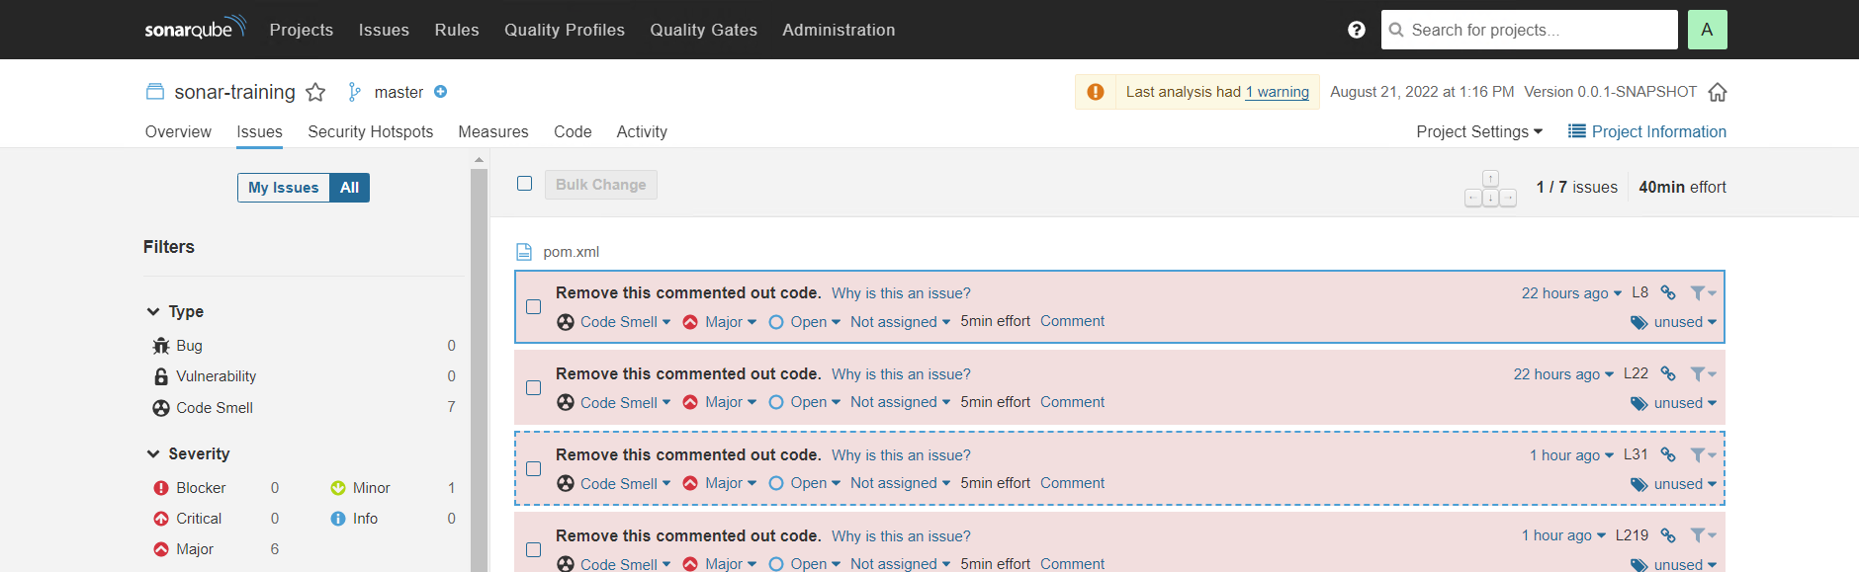
Sonar’s Web-dashboard

Slide 19
Sonar’s Web-dashboard (cont.)
Issues tab:
  severity levels : blocker, critical, major, minor and info
  assign an issue to another user
  comment on it, and change its severity level.
displays the Quality Gate status – passed (green) or failed (red).
Quality Gate :
  how to know if the codebase is healthy enough for deployment into production? With conditions

Slide 20
Quality Gate
a set of conditions the project must meet before it can qualify for production release.
answering one question: is my project ready for release?
can I push my code to production in its current state or not?
You can add custom quality condition to a project for:
  Blocker Issues(each severities), code coverage, duplicated lines,…
Each Quality Gate condition is a combination of:
  a measure(Blocker issue)
  a comparison operator(>)
  an error value(0)

Slide 21
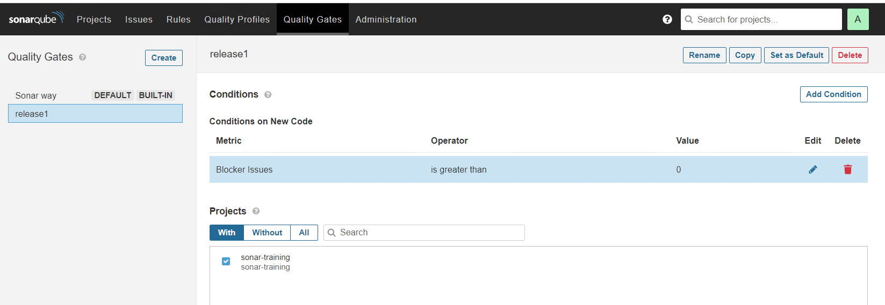

Slide 22
Integrating SonarQube into a CI(continuous integration)
automatically fail the build if the code analysis did not satisfy the Quality Gate condition.
Make change into bamboo plan to use sonar scanner for code quality.
  Bamboo Administration > Apps > Include Code Quality for Bamboo
Add a task to your build plan and install sonar scanner on bambo
Then set the sonar server into bamboo task .(steps are in below )
https://mibexsoftware.atlassian.net/wiki/spaces/SONARBAMBOO/pages/133 9883529/Getting+started
Purpose: check the code quality before daily build and nightly build and update sonar server.
(how to do nightly build ? next slide)

Slide 23
Review of Bamboo(automatic build)
You can build the project in 2 ways in Bamboo:
  Manually (run button)
  Automatic build. (use triggers) //Your plan-> action ->configure plan -> triggers
three types of triggers
Single day build :
  specify a time . for example 1:00 AM run the build every day. Test all your unit tests , is source code ok and not failing?.
Remote trigger:
  Every time a change happens in this repository, it’s going to trigger the build.
Repository polling:
  Default trigger, check the changes in your repository and if it detects changes in your source control system ,it’s going to trigger a build. periodically or scheduled (when check the repository?)

Slide 24
resources
https://www.baeldung.com/jacoco
https://www.javatpoint.com/unit-testing
https://www.javatpoint.com/integration-testing
https://www.baeldung.com/sonar-qube
https://github.com/aminarab/sonar-training
https://docs.sonarqube.org/latest/analysis/bitbucket-integration/
https://mibexsoftware.atlassian.net/wiki/spaces/SONARBAMBOO/pages/1339883529/Getting+started

